Slide 1
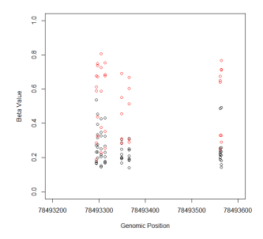
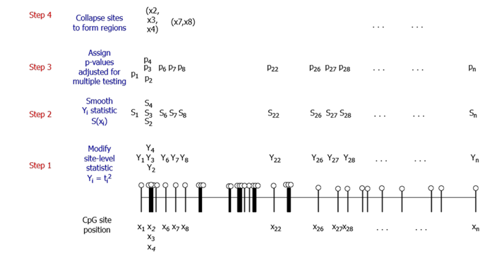
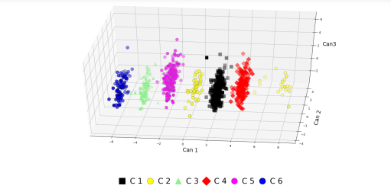
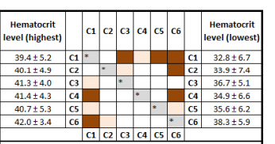
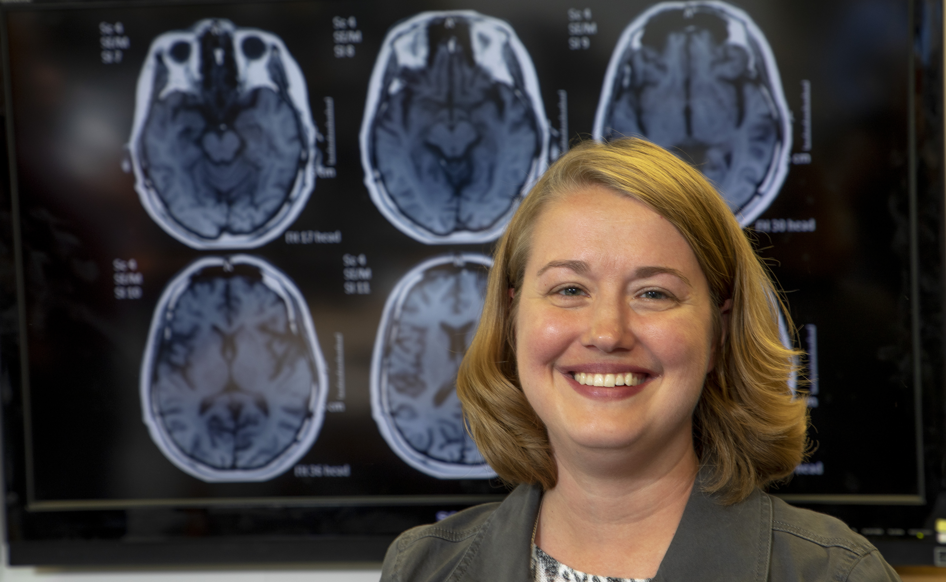
DEPARTMENT OF MATHEMATICS & STATISTICS Missouri University of Science & Technology
Statistical Modeling of Genomic and Biomedical Data
Overall Research Objectives:
Developing statistical methods for inference-based analysis of biological data
Collaborating with scientific teams to answer research questions using statistical methodology
Statistical Genomics Topics:
Detecting Differentially Methylated Regions
Meta-Analysis of Gene Expression Data
Statistical Modeling of Biomedical Data Topics:
Modeling Sleep in the Fruit Fly
Statistical Methods for Explainability in Unsupervised Learning Applications of Biomedical Data
Differential methylation testing
Visualizing and explaining TBI clusters via statistical analysis
PoC
Gayla Olbricht, Professor
E-Mail: olbrichtg@mst.edu
Phone: 1-573-341-4913
Funding
Funding agencies: NIH, Leonard Wood Institute, Missouri Department of Higher Education
Statistical Keywords: Cluster analysis, functional data analysis, imputation, meta-analysis, multivariate statistics, multiple testing, regression
Biomedical Data Keywords: Traumatic brain injury (TBI), sleep, cancer, mesenchymal stem cells
Publications:
Link to my publications

